Slide 1
Universal Customer View
Big Data Demonstration
9th - 11th November

Slide 2
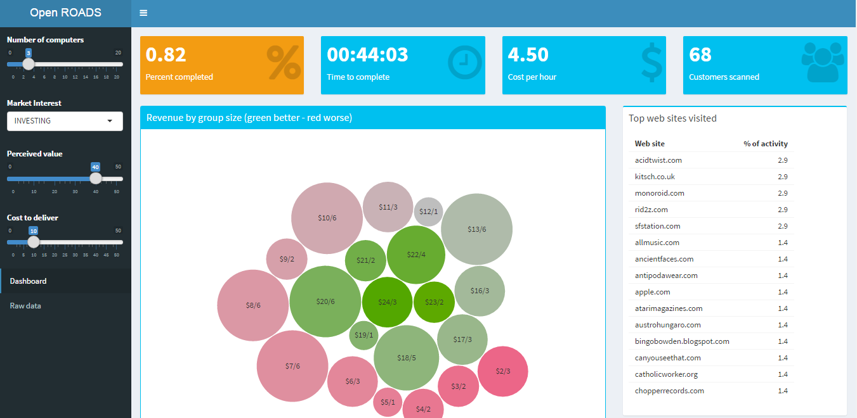
Problem Statement
“Winter is coming!!!” How much money can we make after running a “Game of Thrones” marketing campaign?
Define
Market Interest
Perceived Value
Cost to Deliver
10M customer CRM records*
100M per service per user records*
External demographic data
Run
Monte Carlo
Simulation
Group customers based
on profit
*Simulated data

Slide 3










Solution Architecture
Microsoft Azure
Data
Storage
Hadoop
Cluster
Controller
UI Shinny
Statistics

